Slide 1
EITK – Syllabus for Mid-Term 2

Slide 2



Traditional knowledge in different sectors
Bio Technology
Essence of Indian Traditional Knowledge
Biotechnology is a broad area of biology, involving the use of living systems and organisms to develop or make products. Depending on the tools and applications, it often overlaps with related scientific fields
2020 . All rights reserved. For internal client use only.

Slide 3
Traditional knowledge in different sectors
Bio Technology
Essence of Indian Traditional Knowledge
Biodiversity conservation in Southeast Asia
https://link.springer.com/article/10.1007/s10531-010-9816-y
Governance related to the environment in the countries of Southeast Asia, to counter deforestation and the unsustainable exploitation of the region’s natural environment. Several factors have become important in triggering such debates.
1.The process of democratisation - NGOs and communities gettning heard
2. In some countries attempts at political and administrative decentralisation have been undertaken
3. Agricultural output, long taken for granted, is of renewed importance to national development planners after several countries experienced a food crisis and worrying price rises.
4. climate change and its potentially devastating impact on developing countries have entered the agenda.
5. From a legal perspective, a number of important international treaties linking trade and environmental issues were concluded during the 1990s and they are now entering the implementation stage or are under discussions for further amendments
2020 . All rights reserved. For internal client use only.

Slide 4
Traditional knowledge in different sectors
Bio Technology
Essence of Indian Traditional Knowledge
Biodiversity conservation in Southeast Asia
Convention on Biological Diversity (CBD)
CBD confirms the sovereign rights of States over their natural resources
The authority to determine access to genetic resources rests with the governments and is subject to national legislation
However, while most of the exchange of resources and benefits is framed as a relationship between state parties, “indigenous and local communities embodying traditional lifestyles relevant for the conservation and use of biological diversity” become relevant
The provision requires from state parties to “respect, preserve and maintain knowledge, innovations and practices” of such communities and to “promote their wider application with the approval and involvement of the holders of such knowledge, innovations and practices and encourage the equitable sharing of benefits arising from the utilization of such knowledge, innovations and practices
2020 . All rights reserved. For internal client use only.

Slide 5
Traditional knowledge in different sectors
Agriculture
Essence of Indian Traditional Knowledge
Agriculture in India is involved in domestic food supply, employment and cash income. ... There are six major themes related to Traditional Knowledge –
indigenous practices for water conservation
soil conservation,
plant protection,
unique agricultural practices,
cropping systems and
community level adaptation
2020 . All rights reserved. For internal client use only.

Slide 6
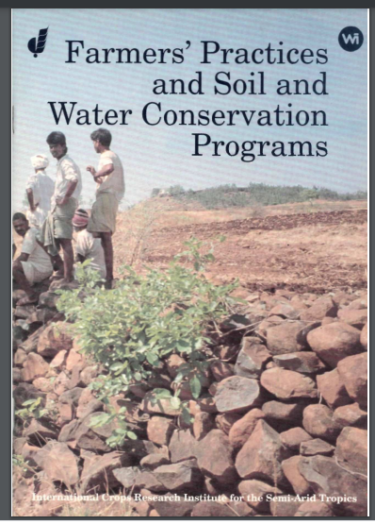
Traditional knowledge in different sectors
Agriculture – Soil and Water Conservation
Essence of Indian Traditional Knowledge
International Crops Research Institute
Andhra Pradesh, 1991
2020 . All rights reserved. For internal client use only.

Slide 7
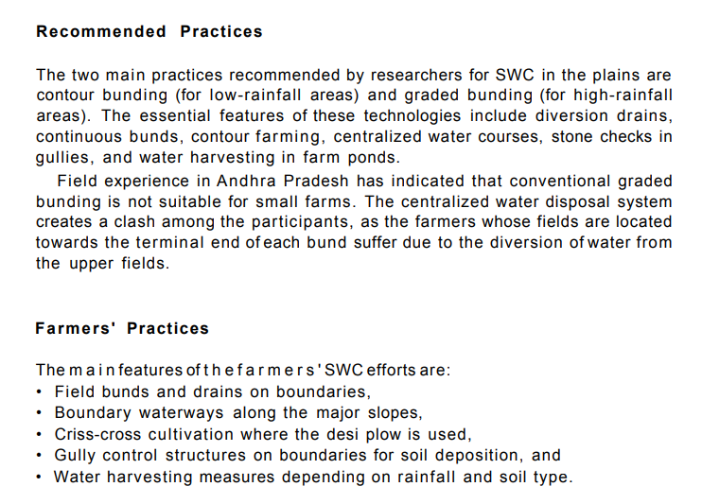
Traditional knowledge in different sectors
Agriculture – Indigenous practices for Soil
& Water Conservation
Essence of Indian Traditional Knowledge
2020 . All rights reserved. For internal client use only.

Slide 8
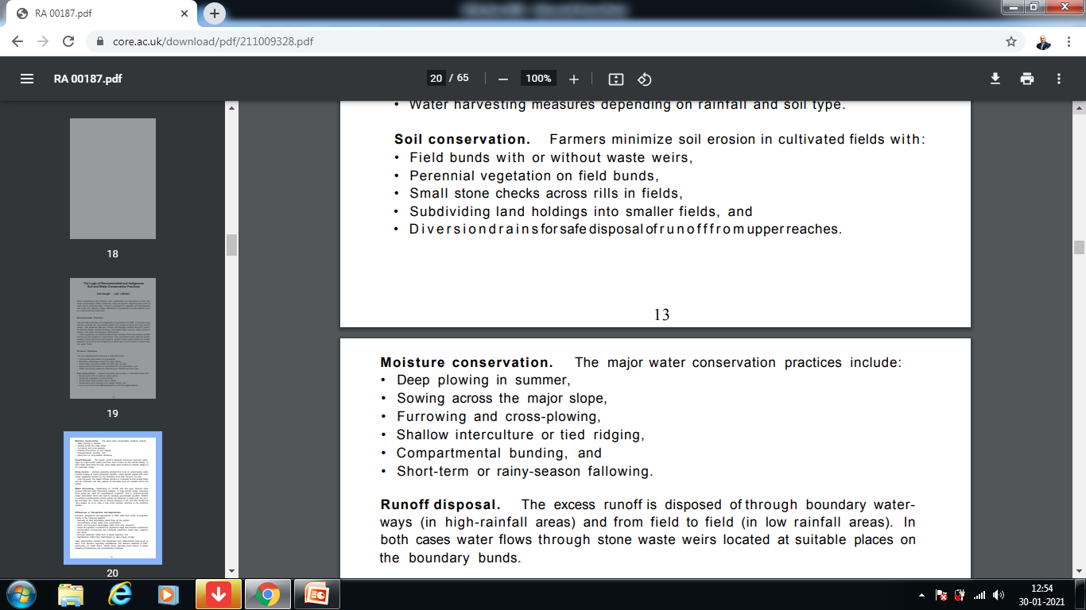
Traditional knowledge in different sectors
Agriculture – Indigenous practices for Soil
& Water Conservation
Essence of Indian Traditional Knowledge
2020 . All rights reserved. For internal client use only.

Slide 9
Traditional knowledge in different sectors
Agriculture – Plant Protection
Essence of Indian Traditional Knowledge
Crop protection is the science and practice of managing plant diseases, weeds and other pests (both vertebrate and invertebrate) that damage agricultural crops and forestry. ... Crop protection encompasses: Pesticide-based approaches such as herbicides, insecticides and fungicides.
Proper crop protection is important to produce higher quality crops with minimal wastage. This increase in productivity leads to less land, water and labour being required for food crops. With less land being used biodiversity is preserved and less greenhouse gases are emitted.
2020 . All rights reserved. For internal client use only.

Slide 10
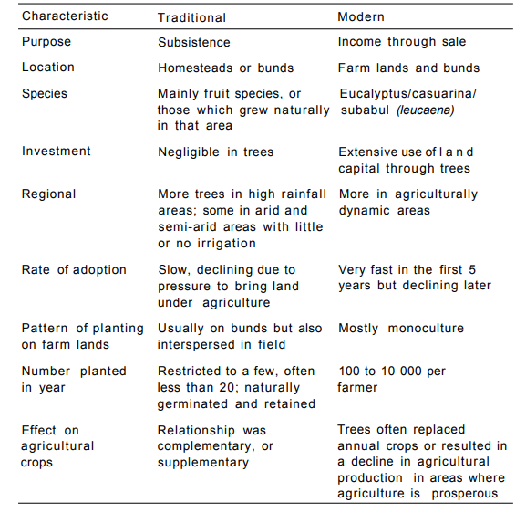
Traditional knowledge in different sectors
Agriculture – Plant Protection (Growing Trees)
Essence of Indian Traditional Knowledge
2020 . All rights reserved. For internal client use only.

Slide 11
Traditional knowledge in different sectors
Agriculture – Unique Agricultural Practices
Essence of Indian Traditional Knowledge
Unique agricultural practices arise in particular regions because of
physical characteristics of the land.
limited knowledge of alternatives.
distinctive cultural traits.
2020 . All rights reserved. For internal client use only.

Slide 12
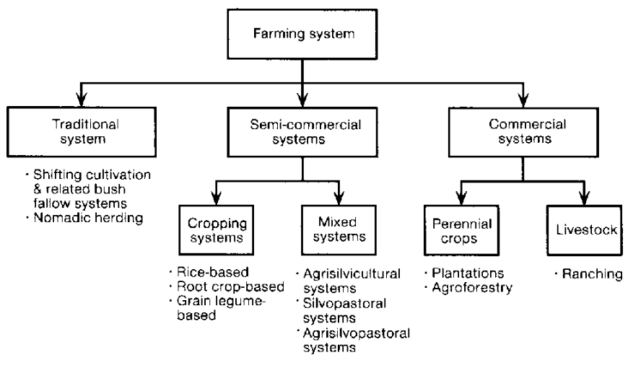
Traditional knowledge in different sectors
Agriculture – Unique Agricultural Practices
Essence of Indian Traditional Knowledge
2020 . All rights reserved. For internal client use only.

Slide 13
Traditional knowledge in different sectors
Agriculture – Unique Agricultural Practices
#1 - Subsistence Farming
Essence of Indian Traditional Knowledge
Majority of farmers in the country practise subsistence farming.
It is characterised by small and scattered land holdings and use of primitive tools.
As the farmers are poor, they do not use fertilisers and high yielding variety of seeds in their fields to the extent they should do.
Facilities like electricity and irrigation are generally not available to them.
Features of Subsistence Farming:
The whole family works on the farm
Most of the work is done manually
The farms are small
Tradition methods of farming are followed
Yield is not very high
Most of the yield is consumed by the family with very little surplus for the family
2020 . All rights reserved. For internal client use only.

Slide 14
Traditional knowledge in different sectors
Agriculture – Unique Agricultural Practices
Shifting Agriculture
Essence of Indian Traditional Knowledge
In this type of agriculture, first of all a piece of forest land is cleared by felling trees and burning of trunks and branches.
After the land is cleared, crops are grown for two to three years and then the land is abandoned as the fertility of the soil decreases.
The farmers then move to new areas and the process is repeated.
Dry paddy, maize, millets and vegetables are the crops commonly grown in this type of farming.
2020 . All rights reserved. For internal client use only.

Slide 15
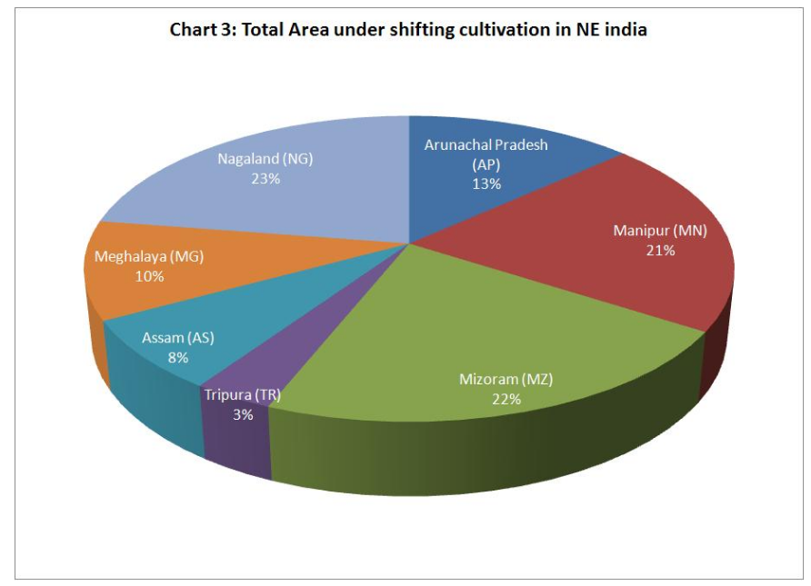
Traditional knowledge in different sectors
Agriculture – Unique Agricultural Practices
Essence of Indian Traditional Knowledge
2020 . All rights reserved. For internal client use only.

Slide 16
Traditional knowledge in different sectors
Agriculture – Unique Agricultural Practices
Plantation Farming
Essence of Indian Traditional Knowledge
Plantation farming is bush or tree farming. It was introduced by the British in the 19th century.
It is a single crop farming of rubber, tea, coffee, cocoa, spices, coconut and fruit crops like apples, grapes, oranges, etc.
It is capital intensive and demands good managerial ability, technical know-how, sophisticated machinery, fertilisers, irrigation, and transport facilities.
Plantation agriculture is an export-oriented agriculture. Most of the crops grown in plantation agriculture have a life cycle of more than two years.
Natural rubber, coconuts, oil palm, tea, cocoa, and coffee are all tree crops and take years to mature, but afterwards they are productive for long periods.
Plantation agriculture is confined within tropical areas, i.e., both sides of the equator. Plantations exist on every continent possessing a tropical climate.
Some of the plantations like tea, coffee and rubber have a processing factory within the farm itself or close to it.
This type of agriculture has developed in hilly areas of north-eastern India, sub-Himalayan West Bengal and in Nilgiri, Anamalai and Cardamom hills in peninsular India.
2020 . All rights reserved. For internal client use only.

Slide 17
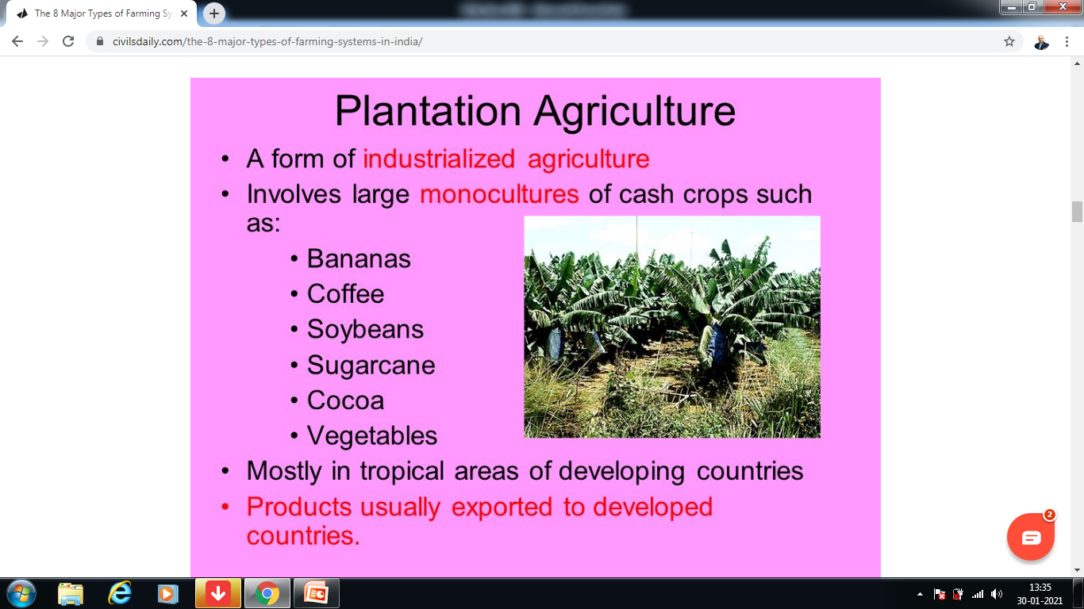
Traditional knowledge in different sectors
Agriculture – Unique Agricultural Practices
Essence of Indian Traditional Knowledge
2020 . All rights reserved. For internal client use only.

Slide 18
Traditional knowledge in different sectors
Agriculture – Unique Agricultural Practices
Intensive Farming
Essence of Indian Traditional Knowledge
In areas where irrigation has been possible, the farmers use fertilisers and pesticides on large scale. They have also brought their land under high yielding variety of seeds. They have mechanised agriculture by introducing machines in various processes of farming.
Also known as industrial agriculture, it is characterized by a low fallow ratio and higher use of inputs such as capital and labour per unit land area. This is in contrast to traditional agriculture in which the inputs per unit land are lower.
2020 . All rights reserved. For internal client use only.

Slide 19
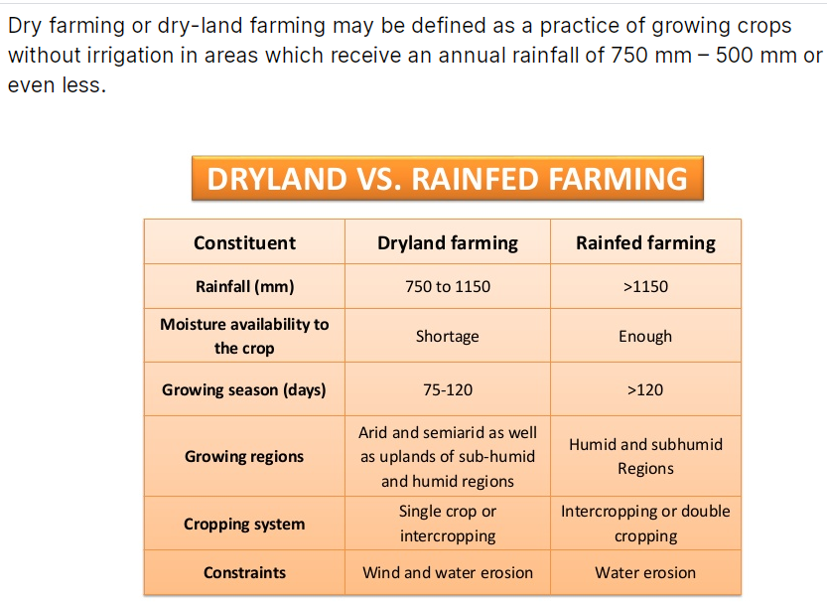
Traditional knowledge in different sectors
Agriculture – Unique Agricultural Practices
Dry Farming
Essence of Indian Traditional Knowledge
2020 . All rights reserved. For internal client use only.

Slide 20
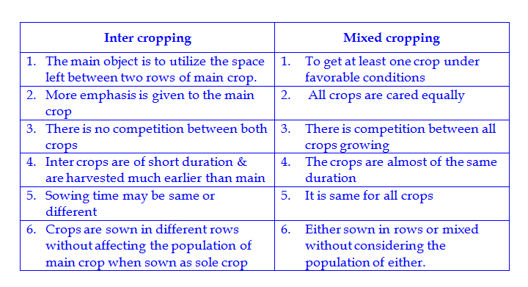
Traditional knowledge in different sectors
Agriculture – Unique Agricultural Practices
Mixed and Multiple Farming
Essence of Indian Traditional Knowledge
2020 . All rights reserved. For internal client use only.

Slide 21
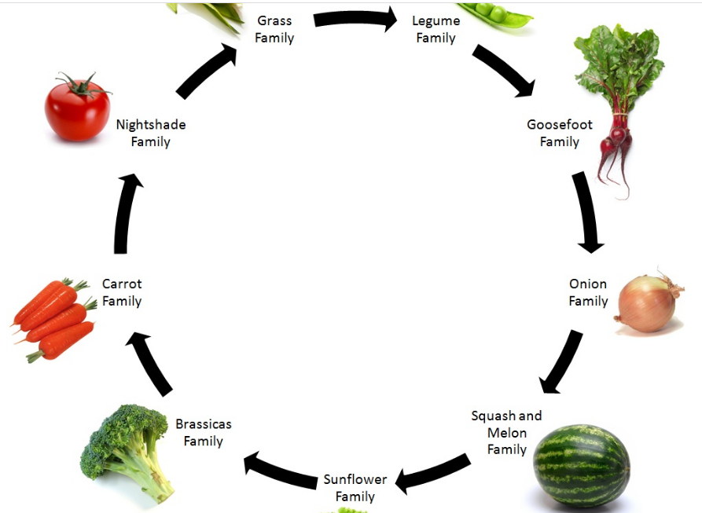
Traditional knowledge in different sectors
Agriculture – Unique Agricultural Practices
Crop Rotation
Essence of Indian Traditional Knowledge
2020 . All rights reserved. For internal client use only.

Slide 22
Traditional knowledge in different sectors
Agriculture – Unique Agricultural Practices
Crop Rotation
Essence of Indian Traditional Knowledge
This refers to growing of number of Crops one after the other in a fixed rotation to maintain the fertility of the soil. The rotation of crops may be complete in a year in some of the areas while it may involve more than one year’s time is others.
Pulses or any leguminous crop is grown after the cereal crops.
Legumes have the ability of fixing nitrogen to the soil.
Highly fertilizer intensive crops like sugarcane or tobacco are rotated with cereal crops.
The selection of crops for rotation depends upon the local soil conditions and the experience and the understanding of the farmers.
2020 . All rights reserved. For internal client use only.

Slide 23
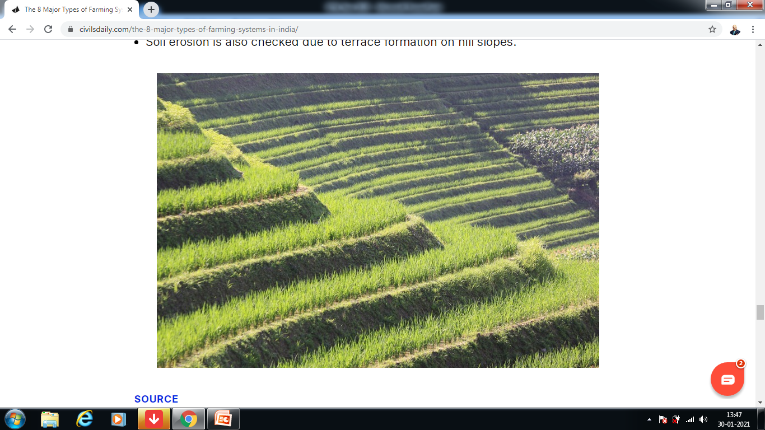
Traditional knowledge in different sectors
Agriculture – Unique Agricultural Practices
Terrace Farming
Essence of Indian Traditional Knowledge
2020 . All rights reserved. For internal client use only.

Slide 24
Traditional knowledge in different sectors
Agriculture – Cropping Systems
Essence of Indian Traditional Knowledge
The term cropping system refers to the crops, crop sequences and management techniques used on a particular agricultural field over a period of years. It includes all spatial and temporal aspects of managing an agricultural system.
2020 . All rights reserved. For internal client use only.

Slide 25
Traditional knowledge in different sectors
Agriculture – Cropping Systems
Essence of Indian Traditional Knowledge
Monocropping: Example Planting Wheat year after year in the same field. Monocropping is when the field is used to grow only one crop season after season.
Disadvantages: it is difficult to maintain cover on the soil; it encourages pests, diseases and weeds; and it can reduce the soil fertility and damage the soil structure.
2020 . All rights reserved. For internal client use only.

Slide 26
Traditional knowledge in different sectors
Agriculture – Cropping Systems
Essence of Indian Traditional Knowledge
Crop Rotation: Example Planting maize one year, and beans the next. Crop Rotation means changing the type of crops grown in the field each season or each year (or changing from crops to fallow).
Crop rotation is a key principle of agriculture conservation because it improves the soil structure and fertility, and because it helps control weeds, pests and diseases.
2020 . All rights reserved. For internal client use only.

Slide 27
Traditional knowledge in different sectors
Agriculture – Cropping Systems
Essence of Indian Traditional Knowledge
Sequential Cropping: Example- Planting maize in the long rains, then beans during the short rains. Sequential Cropping involves growing two crops in the same field, one after the other in the same year.
In some places, the rainy season is long enough to grow two crops: either two main crops, or one main crop followed by a cover crop.
Growing Crops two crops may also be possible if there are two rainy seasons, or if there is enough moisture left in the soil to grow a second crop.
2020 . All rights reserved. For internal client use only.

Slide 28
Traditional knowledge in different sectors
Agriculture – Cropping Systems
Essence of Indian Traditional Knowledge
Intercropping: Examples- Planting alternating rows of maize and beans, or growing a cover crop in between the cereal rows. Intercropping means growing two or more crops in the same field at the same time.
2020 . All rights reserved. For internal client use only.

Slide 29
Traditional knowledge in different sectors
Agriculture – Cropping Systems
Essence of Indian Traditional Knowledge
Mixed Intercropping: Distribution of the seeds of both the crops, or dibbling the seeds without any row arrangement. This process is called mixed intercropping. It is easy to do but makes weeding, fertilization and harvesting difficult. Individual plants may compete with each other because they are too close together.
Planting the main crop in rows and then spreading the seeds of the intercrop (such as a cover crop).
2020 . All rights reserved. For internal client use only.

Slide 30
Traditional knowledge in different sectors
Agriculture – Cropping Systems
Essence of Indian Traditional Knowledge
Row Intercropping: Planting both the main crop and the intercrop in rows. This is called row intercropping. The rows make weeding and harvesting easier than with mixed intercropping.
2020 . All rights reserved. For internal client use only.

Slide 31
Traditional knowledge in different sectors
Agriculture – Cropping Systems
Essence of Indian Traditional Knowledge
Stir Cropping: Example Planting alternating strips of maize, soybean and finger millet. Stir Cropping involves planting broad strips of several crops in the field. Each strip is 3–9 m wide. On slopes, the strips can be laid out along the contour to prevent erosion. The next year, the farmer can rotate crops by planting each strip with a different crop.
Advantages:
It produces a variety of crops, the legume improves the soil fertility, and rotation helps reduce pest and weed problems.
The residues from one strip can be used as soil cover for neighbouring strips.
At the same time, strip cropping avoids some of the disadvantages of intercropping: managing the single crop within the strip is easy, and competition between the crops is reduced.
2020 . All rights reserved. For internal client use only.

Slide 32
Traditional knowledge in different sectors
Agriculture – Cropping Systems
Essence of Indian Traditional Knowledge
Relay Cropping: Example- Planting maize, then sowing beans between the maize rows four weeks later.
Relay Cropping the process of growing one crop, then planting another crop (usually a cover crop) in the same field before harvesting the first. This helps avoid competition between the main crop and the intercrop. It also uses the field for a longer time, since the cover crop usually continues to grow after the main crop is harvested
2020 . All rights reserved. For internal client use only.

Slide 33
Traditional knowledge in different sectors
Agriculture – Community Level Adaptation
Essence of Indian Traditional Knowledge
Community-based adaptation (CBA) is a form of adaptation that aims to reduce the risks of climate change to the world's poorest people by involving them in the practices and planning of adaptation
There are two main purposes in using CBA: To determine if the project is sound, justifiable and feasible by figuring out if its benefits outweigh costs. To offer a baseline for comparing projects by determining which project's benefits are greater than its costs.
2020 . All rights reserved. For internal client use only.

Slide 34
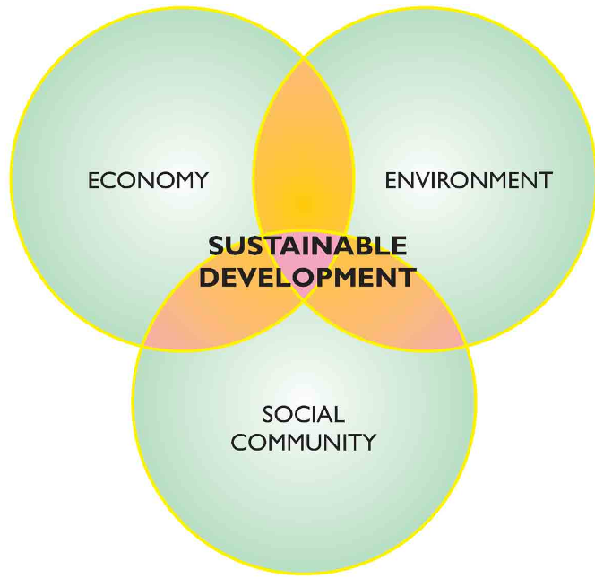
Traditional knowledge in different sectors
Sustainable Development
Essence of Indian Traditional Knowledge
2020 . All rights reserved. For internal client use only.

Slide 35
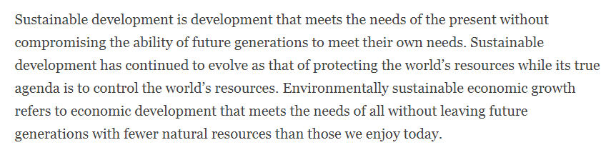
Traditional knowledge in different sectors
Sustainable Development
Essence of Indian Traditional Knowledge
2020 . All rights reserved. For internal client use only.

Slide 36
Traditional knowledge in different sectors
Sustainable Development
Essence of Indian Traditional Knowledge
The concept of sustainable development was introduced in early 1980’s (in particular through the publication of the World Conservation Strategy by IUCN, UNEP and WWF, 1980), in order to reconcile conservation and development objectives. Since then, it has evoked much discussion.
The aim of sustainable development is to balance our economic, environmental and social needs, allowing prosperity for now and future generations. Sustainable development consists of a long-term, integrated approach to developing and achieving a healthy community by jointly addressing economic, environmental, and social issues, whilst avoiding the over consumption of key natural resources.
Sustainable development encourages us to conserve and enhance our resource base, by gradually changing the ways in which we develop and use technologies. Countries must be allowed to meet their basic needs of employment, food, energy, water and sanitation.
If this is to be done in a sustainable manner, then there is a definite need for a sustainable level of population. Economic growth should be supported and developing nations should be allowed a growth of equal quality to the developed nations. There are four objectives of sustainable development
These include social progress and equality, environmental protection, conservation of natural resources and stable economic growth. Everybody has the right to a healthy, clean and safe environment. Everybody has the right to a healthy, clean and safe environment

Slide 37
Traditional knowledge in different sectors
Sustainable Development
Essence of Indian Traditional Knowledge
This can be achieved by reducing pollution, poverty, poor housing and unemployment. No one, in this age, or in the future should be treated unfairly. Global environmental threats, such as climate change and poor air quality must be reduced to protect human and environmental health. The use of non­-renewable resources such as fossil fuels should not be stopped overnight, but they must be used efficiently and the development of alternatives should be encouraged to help phase them out.
Everybody has the right to a good standard of living, with better job opportunities. Economic prosperity is required if our country is to prosper and our businesses must therefore offer a high standard of products that consumers throughout the world want, at the prices they are prepared to pay. For this, we need a workforce equipped with suitable skills and education within a framework to support them.

Slide 38
Traditional knowledge in different sectors
Sustainable Development
Essence of Indian Traditional Knowledge
In 1987 Brunt-land Commission prescribed: “Sustainable development meets the needs of the present without compromising the ability of future generations to meet their own needs”.
It has got certain objectives or goals to achieve for the over-all development of mankind:
1. We are common, having same future.
2. The development process must be participatory, from all sections of people.
3. The objectives are same but ways might be different.
4. The development process must be balanced and conducive with nature.
5. The development process must be continuous and long-term.
6. Equal distribution and social justice should be taken care of.
7. All development process must be integrated and coordinated.
Robert Repetto (1986) in his book ‘Global Possible’ said that sustainable development is a continuous process that considers all natural and human resources as a means to achieve certain goals or objectives. This development process should not be contradictory with nature. Rather, it should be corollary with natural productive process.

Slide 39
Traditional knowledge in different sectors
Sustainable Development
Essence of Indian Traditional Knowledge
Despite difference of opinions among different countries, commissions and international agencies, major objectives of sustainable development can be earmarked very easily:
A. Provision of basic human requirements like food, shelter, clothing, health, educa­tion etc. with minimum disturbance of natural eco-systems.
B. Environment and bio-diversity should be preserved for the ultimate future of mankind.
C. Individuals and countries should be integrated to the process of sustainable de­velopment.

Slide 40
Traditional knowledge in different sectors
Sustainable Development
Essence of Indian Traditional Knowledge
The Norway Round Table, in 1995, laid down some basic principles on sustainable development.
To achieve the goal of sustainable development, the convention uttered:
“The use of goods and services that respond to basic needs and bring a better quality of life, while minimizing the use of natural resources, toxic materials and emissions of waste and pollutants over the life cycle, so as not to jeopardize the needs of future generations”.
Regarding the identification of problems of sustainability and recommending the way out, the convention pointed out some key aspects:
i. Unsustainable consumption pattern is more visible in physical infrastructures like energy, housing, transport and waste management. Cultural habits and societal outlook is responsible for that.
ii. The business and industrialist community has specific role to manage environ­mental impacts of the goods and services it provides.
iii. Political institutions have a role to change consumption pattern rather than con­sumption volumes.
iv. For rectification in chain of production-consumption and final disposal govern­ment must provide incentive measures, infrastructural facilities, proper leader­ship and legislative regulations.
v. Responsible organizations like trade unions must involve themselves in the agenda of consumption and production pattern change.
vi. Individuals have the great role in different aspects like consumer, householder, worker, decision-maker and even as voter.

Slide 41
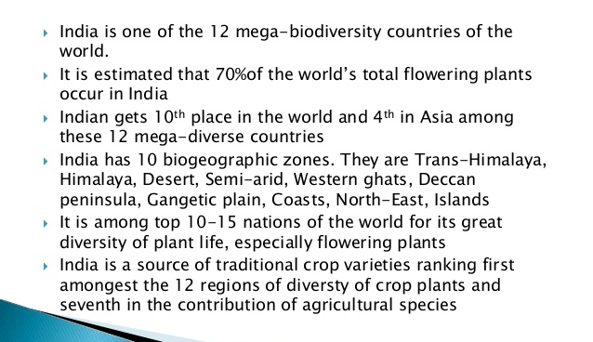
Traditional knowledge in different sectors
Management of biodiversity,
Food security of the country
Essence of Indian Traditional Knowledge

Slide 42
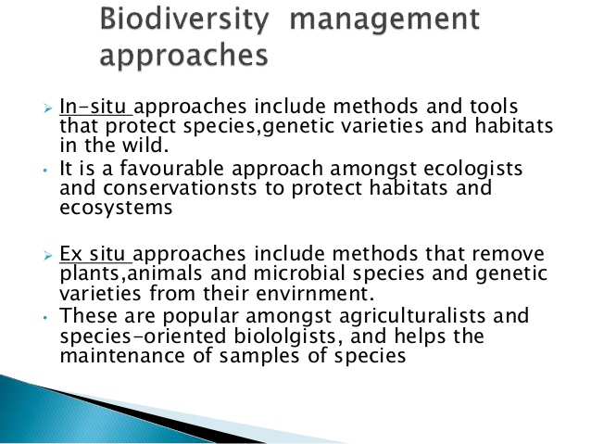
Traditional knowledge in different sectors
Essence of Indian Traditional Knowledge

Slide 43
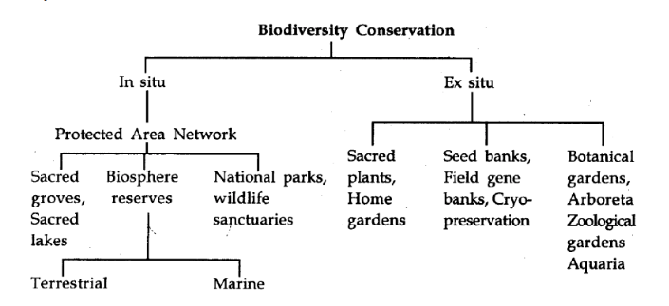
Traditional knowledge in different sectors
Essence of Indian Traditional Knowledge

Slide 44
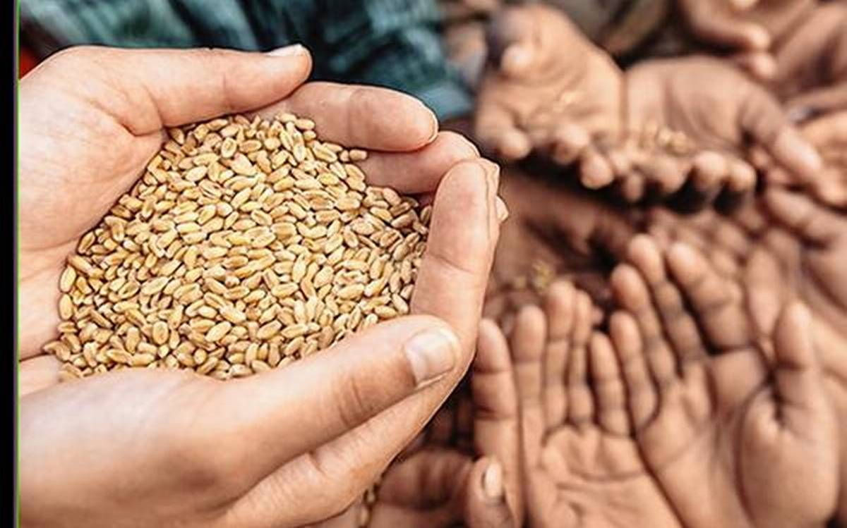
Traditional knowledge in different sectors
Food security of the country
Essence of Indian Traditional Knowledge
Food security has been a major concern in India. According to UN-India, there are nearly 195 million undernourished people in India, which is a quarter of the world's hunger burden. ... India ranks 74 out of 113 major countries in terms of food security index.

Slide 45
Traditional knowledge in different sectors
Food security of the country
Essence of Indian Traditional Knowledge
The Challenge
With nearly 195 million undernourished people, India shares a quarter of the global hunger burden. Nearly 47 million or 4 out of 10 children in India are not meeting their full human potential because of chronic undernutrition or stunting. Stunting has consequences such as diminished learning capacity, poor school performance, reduced earnings and increased risks of chronic diseases. The impacts are multi-generational as malnourished girls and women often give birth to low birth-weight infants. There has also been an increase in the prevalence of overweight and obesity in children and adolescents in India, which has life-long consequences of non-communicable diseases in adulthood.
The government has large food security and anti-poverty programmes but there are critical gaps in terms of inclusion and exclusion errors. Women and girls are particularly disadvantaged. Despite the achievement of national food self-sufficiency, new challenges have emerged: Slowing agriculture growth, climate change, land degradation and shrinking bio-diversity. Large tracts of farmlands in India have become barren due to imbalanced fertiliser use and excessive use of a single fertiliser, urea.

Slide 46
Traditional knowledge in different sectors
Food security of the country
Essence of Indian Traditional Knowledge
Government of India Programmes and Initiatives
With a five-fold increase in food grain production from 50 million tonnes in 1950-51 to about 250 million tonnes in 2014-15, India has moved away from dependence on food aid to become a net food exporter. In 2016, the government launched a number of programmes to double farmers’ incomes by 2022. These seek to remove bottlenecks for greater agricultural productivity, especially in rain-fed areas. They include: the National Food Security Mission, Rashtriya Krishi Vikas Yojana (RKVY), the Integrated Schemes on Oilseeds, Pulses, Palm oil and Maize (ISOPOM), Pradhan Mantri Fasal Bima Yojana, the e-marketplace, as well as a massive irrigation and soil and water harvesting programme to increase the country’s gross irrigated area from 90 million hectares to 103 million hectares by 2017.
The government has also taken significant steps to combat under- and malnutrition over the past two decades, such as through the introduction of mid-day meals at schools, anganwadi systems to provide rations to pregnant and lactating mothers, and subsidised grain for those living below the poverty line through a public distribution system. The National Food Security Act (NFSA), 2013, aims to ensure food and nutrition security for the most vulnerable through its associated schemes and programmes, making access to food a legal right.

Slide 47
Traditional knowledge in different sectors
Food security of the country
Essence of Indian Traditional Knowledge
UN Support
To address the linked nutrition and livelihood challenges in India and to ensure that vulnerable groups are not left behind, the UN priority group partners with the government to scale-up nutrition services and improve feeding and caring practices in the home. It assists government efforts to increase the efficiency and effectiveness of the safety nets under the NFSA, and work towards increasing farm incomes for small and marginal farming households. The group provides support the strengthening of agriculture and livelihood dimensions of anti-poverty programmes, particularly the Mahatma Gandhi National Rural Employment Guarantee Act and the National Rural Livelihoods Mission.
In previous years, the group has collaborated with the Ministry of Health and Family Welfare to hold a national consultation on wheat flour fortification, and with the Food Safety and Standards Authority of India to organise a workshop on advocating for a national food fortification policy.
Led by the United Nations Children’s Fund (UNICEF), the priority groups members include the Food and Agriculture Organization (FAO), International Fund for Agricultural Development (IFAD), International Labour Organization (ILO), International Organization for Migration (IOM), United Nations Entity for Gender Equality and the Empowerment of Women (UN Women), United Nations Development Programme (UNDP), United Nations Educational, Scientific and Cultural Organization (UNESCO) and World Food Programme (WFP).

Slide 48
Traditional knowledge in different sectors
Protection of Traditional Knowledge
Essence of Indian Traditional Knowledge
International Regime
Joint initiative taken by WIPO and UNESCO - Protection of Expressions of Folklore against Illicit exploitation and other prejudicial Actions in 1982
Adoption of the Convention on Bio Diversity - broadened the scope and mandate of protection with wider objectives
Inter-governmental bodies
World Trade Organization (WTO) and its Council for Trips,
World intellectual Property Organization (WIPO),
Food and Agriculture Organization (FAO),
United Nations Conference on Trade and Development (UNCTAD) and
World Health Organization (WHO)

Slide 49
Traditional knowledge in different sectors
Protection of Traditional Knowledge
Essence of Indian Traditional Knowledge
National Regime
No Traditional Knowledge specific legislations but measures have been adopted
Biodiversity Act, 2002 and Protection of Plant variety and
Farmers Right Act, 2001 and the
Patent (Amendment) Act, 2005 to give effect to its obligations under the TRIPS agreement,
CBD and
International Treaty on Plant Genetic Resources for Food and Agriculture 2004.
Preparation of village-wise Community biodiversity Registers (CBRs) for documenting all knowledge, innovations and practices has been undertaken in a few States.
An exercise has been initiated to prepare to easily navigate computerized database of documentation Traditional Knowledge relating to use of medicinal and other plants, known as Traditional knowledge Digital Library (TKDL).

